Slide 1
CSE 220
Data Structures
Lecture 01:
Introduction to Time and Space Complexity
Anwarul Bashir Shuaib [AWBS]
Lecturer
Department of Computer Science and Engineering
BRAC University

Slide 2
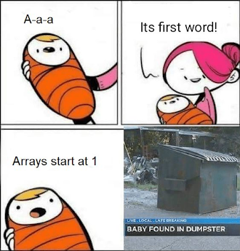
Topics to Review
1D Arrays:
  Declaration, initialization, and traversal.
  Insertion, deletion, and updating elements.
  Searching (Linear Search).
  Sorting (Bubble Sort, Selection Sort, Insertion Sort).
2D Arrays:
  Declaration, initialization, and traversal.
  Row-major and column-major storage.
  Common operations (matrix addition, multiplication, transpose).
Pointers (Optional but Useful) – Understanding array-pointer relationship for dynamic memory allocation.

Slide 3
Why Is Complexity Important?
Efficiency Matters:
  As input size grows, some algorithms become too slow or use too much memory.
  Complexity helps us predict how an algorithm will perform as input scales.
Real-World Problems:
  Computers are fast, but real-world problems can be huge (e.g., multiplying giant matrices or searching through millions of records).
  Even with powerful computers, inefficient programs can take too long or use too much memory.

Slide 4
Why Is Complexity Important?
Efficiency Matters:
  As input size grows, some algorithms become too slow or use too much memory.
  Complexity helps us predict how an algorithm will perform as input scales.
Real-World Problems:
  Computers are fast, but real-world problems can be huge (e.g., multiplying giant matrices or searching through millions of records).
  Even with powerful computers, inefficient programs can take too long or use too much memory.

Slide 5
Why Is Complexity Important?
Efficiency Matters:
  As input size grows, some algorithms become too slow or use too much memory.
  Complexity helps us predict how an algorithm will perform as input scales.
Real-World Problems:
  Computers are fast, but real-world problems can be huge (e.g., multiplying giant matrices or searching through millions of records).
  Even with powerful computers, inefficient programs can take too long or use too much memory.

Slide 6
Why Is Complexity Important?
Efficiency Matters:
  As input size grows, some algorithms become too slow or use too much memory.
  Complexity helps us predict how an algorithm will perform as input scales.
Real-World Problems:
  Computers are fast, but real-world problems can be huge (e.g., multiplying giant matrices or searching through millions of records).
  Even with powerful computers, inefficient programs can take too long or use too much memory.

Slide 7
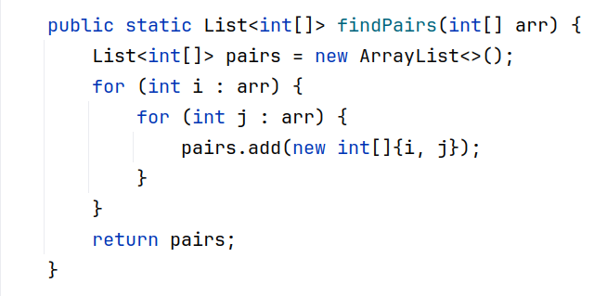
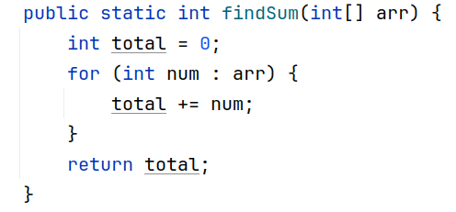
Which Code Runs Faster?

Slide 8



Which Code Runs Faster?

Slide 9



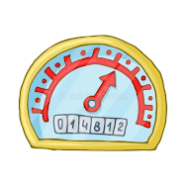
What is Big-O? (Simplified!)
Big-O is like a "speedometer" for your code.
  It tells you how fast your code runs or how much memory it uses as the input grows.
  It’s Not Exact: Big-O doesn’t count every single step. Instead, it gives you a general idea of how your code scales.
Example:
  If your code takes steps, Big-O simplifies it to
  Why? Because as n gets really big, the part dominates the others

Slide 10
What is Big-O? (Simplified!)
Big-O is like a "speedometer" for your code.
  It tells you how fast your code runs or how much memory it uses as the input grows.
  It’s Not Exact: Big-O doesn’t count every single step. Instead, it gives you a general idea of how your code scales.
Example:
  If your code takes steps, Big-O simplifies it to
  Why? Because as n gets really big, the part dominates the others

Slide 11
What is Big-O? (Simplified!)
Big-O is like a "speedometer" for your code.
  It tells you how fast your code runs or how much memory it uses as the input grows.
  It’s Not Exact: Big-O doesn’t count every single step. Instead, it gives you a general idea of how your code scales.
Example:
  If your code takes steps, Big-O simplifies it to
  Why? Because as n gets really big, the part dominates the others

Slide 12
What is Big-O? (Simplified!)
Big-O is like a "speedometer" for your code.
  It tells you how fast your code runs or how much memory it uses as the input grows.
  It’s Not Exact: Big-O doesn’t count every single step. Instead, it gives you a general idea of how your code scales.
Example:
  If your code takes steps, Big-O simplifies it to
  Why? Because as n gets really big, the part dominates the others

Slide 13
What is Big-O? (Simplified!)
Big-O is like a "speedometer" for your code.
  It tells you how fast your code runs or how much memory it uses as the input grows.
  It’s Not Exact: Big-O doesn’t count every single step. Instead, it gives you a general idea of how your code scales.
Example:
  If your code takes steps, Big-O simplifies it to
  Why? Because as n gets really big, the part dominates the others

Slide 14
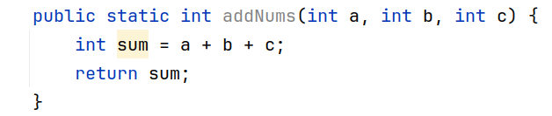
How do we find the complexity?

Slide 15

How do we find the complexity?
Exact run time complexity:

Slide 16
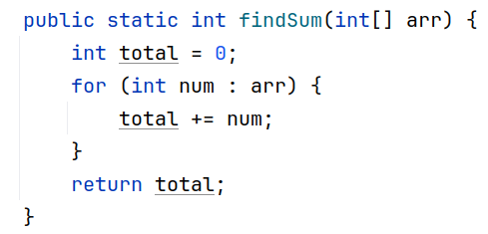

How do we find the complexity?
Exact run time complexity:

Slide 17
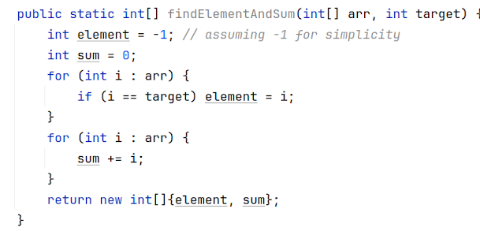
How do we find the complexity?
Exact run time complexity:

Slide 18
How do we find the complexity?
We only consider the worst-case scenario
Exact run time complexity:

Slide 19
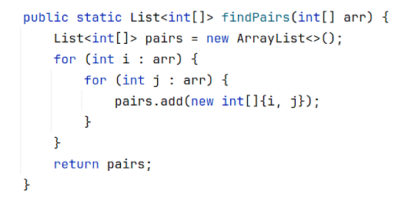

How do we find the complexity?
Exact run time complexity:

Slide 20
How do we find the complexity?
Exact run time complexity:
Think: Why n*n instead of n+n?

Slide 21
What Is Asymptotic Complexity?
Big-O focuses on how an algorithm’s performance scales as the input size (n) grows.
We ignore constant factors and lower-order terms because they become insignificant for large inputs.
This Big-O notation is called the “Order of Growth”

Slide 22
What Is Asymptotic Complexity?
Big-O focuses on how an algorithm’s performance scales as the input size (n) grows.
We ignore constant factors and lower-order terms because they become insignificant for large inputs.
This Big-O notation is called the “Order of Growth”

Slide 23
What Is Asymptotic Complexity?
Big-O focuses on how an algorithm’s performance scales as the input size (n) grows.
We ignore constant factors and lower-order terms because they become insignificant for large inputs.
This Big-O notation is sometimes called the “Order of Growth”

Slide 24
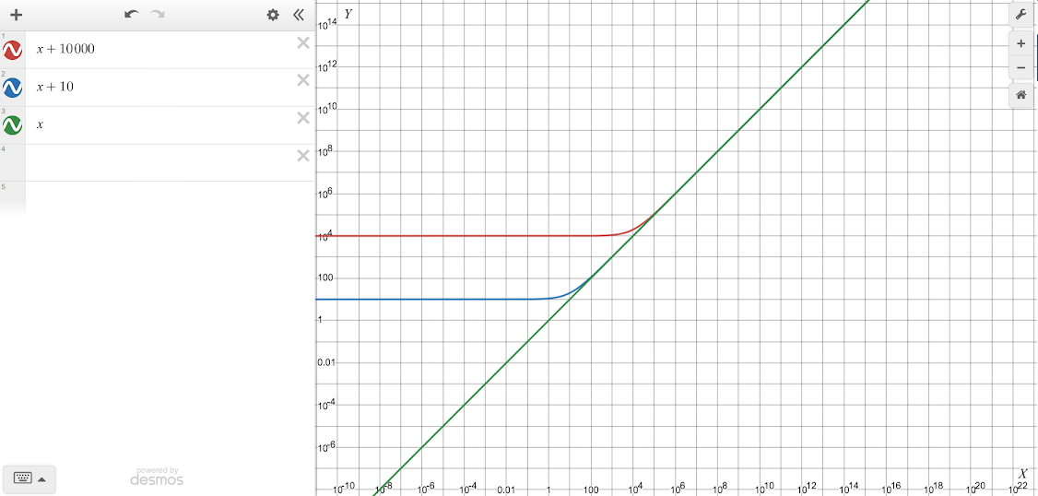
What Is Asymptotic Complexity?
*Axes have been scaled to logarithmic for better visualization

Slide 25
What Is Asymptotic Complexity?
These constants become insignificant as x grows
*Axes have been scaled to logarithmic for better visualization

Slide 26
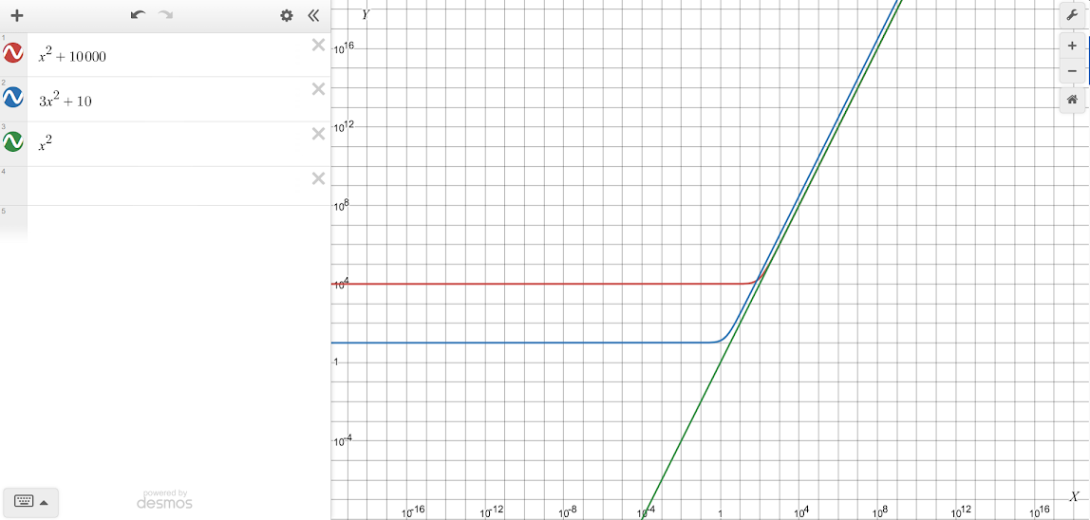
What Is Asymptotic Complexity?
These constants become insignificant as x grows
*Axes have been scaled to logarithmic for better visualization

Slide 27
How do we find the order of growth?
Exact run time complexity:

Slide 28

How do we find the order of growth?
Exact run time complexity:
Asymptotic complexity:

Slide 29
How do we find the order of growth?
Exact run time complexity:
Asymptotic complexity: → Constant Time

Slide 30
How do we find the order of growth?
Exact run time complexity:

Slide 31
How do we find the order of growth?
Exact run time complexity:
Asymptotic complexity: → Linear Time

Slide 32
How do we find the order of growth?
Exact run time complexity:

Slide 33
How do we find the order of growth?
Exact run time complexity:
Asymptotic complexity: → Linear Time

Slide 34
How do we find the order of growth?
Exact run time complexity:

Slide 35
How do we find the order of growth?
Exact run time complexity:
Asymptotic complexity: → Quadratic Time

Slide 36
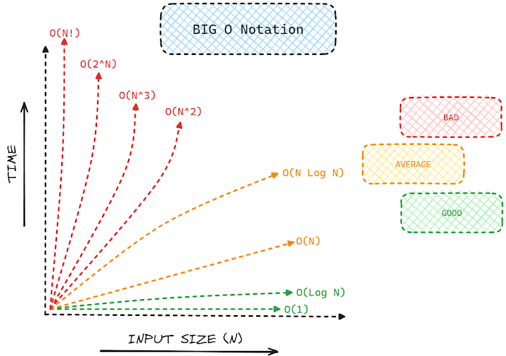
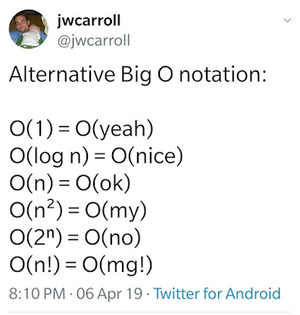
So...What Should We Prefer?

Slide 37
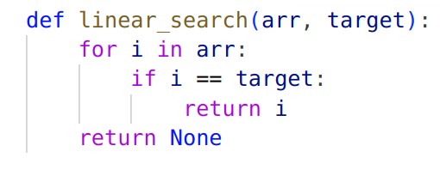

Practice
How would we perform a linear search in an array? What would be its time complexity (the order of growth)?
Time complexity:

Slide 38
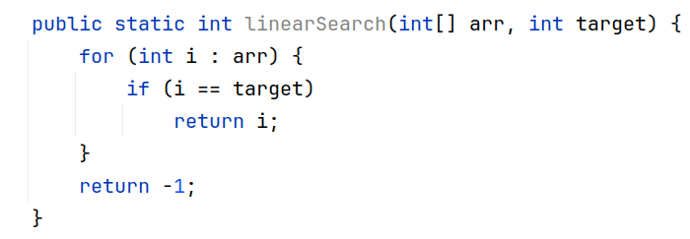
Practice
How would we perform a linear search in an array? What would be its time complexity (the order of growth)?
Time complexity:

Slide 39
Practice
How would we perform a linear search in an array? What would be its time complexity (the order of growth)?
Time complexity:

Slide 40
Practice
How would we perform a linear search in an array? What would be its time complexity (the order of growth)?
Time complexity:
Think: Why O(n)? Why not O(1) when the target is at arr[0]?

Slide 41
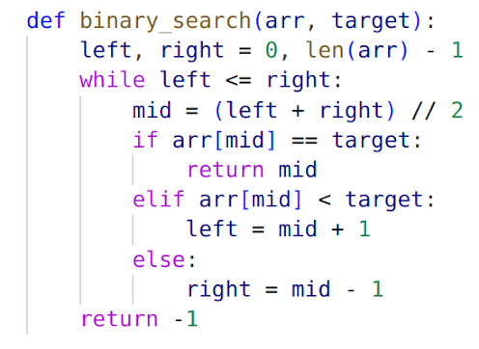

Practice
Can we improve it? What if the array is sorted beforehand?
See a nice demo here
Time complexity: ⇒ Logarithmic space

Slide 42
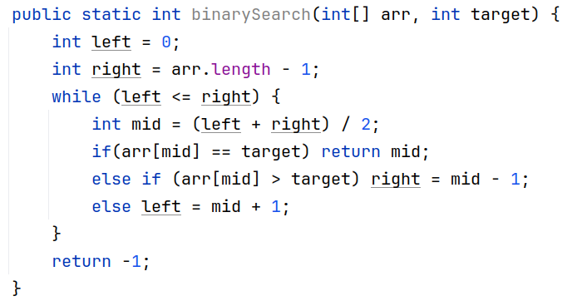
Practice
Can we improve it? What if the array is sorted beforehand?
See a nice demo here
Time complexity: ⇒ Logarithmic space

Slide 43
Practice
Can we improve it? What if the array is sorted beforehand?
See a nice demo here
Time complexity: ⇒ Logarithmic time

Slide 44
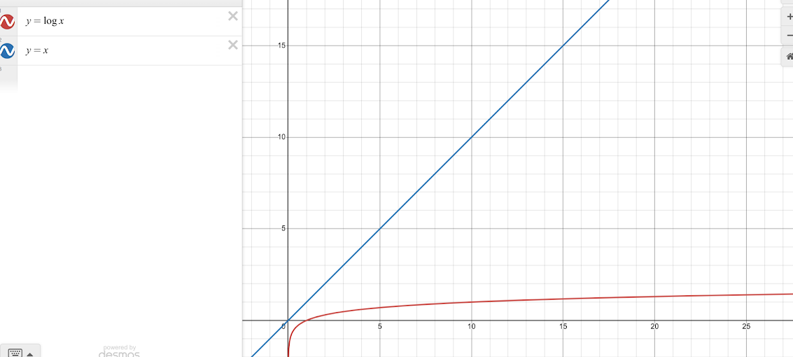
Seeing the Impact!

Slide 45
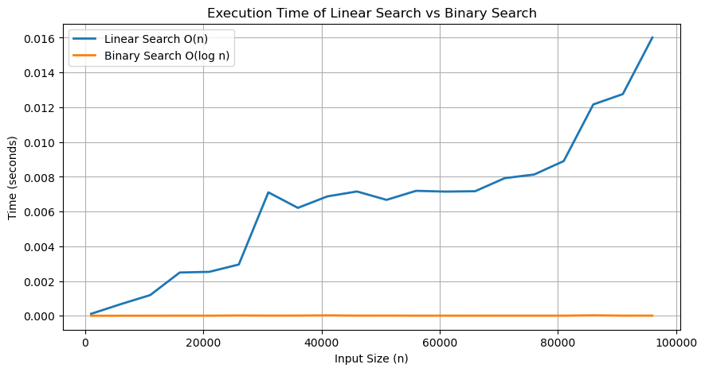
Seeing the Impact!

Slide 46
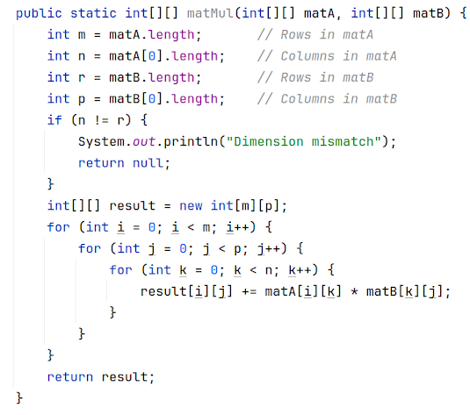
Practice
What about 2D matrix multiplication?

Slide 47


Practice
What about 2D matrix multiplication?
Time complexity:

Slide 48

The Power of Efficient Algorithms
Converting an algorithm to can make the difference between impossible and practical.
Say, n=1000000, 2GHz CPU (2x10^9 operations / second)
  With O(n^3) ⇒ 10^18 operations ⇒ approx 16 years!
  With O(n^2) ⇒ 10^12 operations ⇒ 8.3 minutes!

Slide 49
The Power of Efficient Algorithms
Converting an algorithm to can make the difference between impossible and practical.
Say, n=1000000, 2GHz CPU (2x10^9 operations / second)
  With O(n^3) ⇒ 10^18 operations ⇒ approx 16 years!
  With O(n^2) ⇒ 10^12 operations ⇒ 8.3 minutes!

Slide 50
The Power of Efficient Algorithms
Converting an algorithm to can make the difference between impossible and practical.
Say, n=1000000, 2GHz CPU (2x10^9 operations / second)
  With O(n^3) ⇒ 10^18 operations ⇒ approx 16 years!
  With O(n^2) ⇒ 10^12 operations ⇒ 8.3 minutes!

Slide 51
The Power of Efficient Algorithms
Converting an algorithm to can make the difference between impossible and practical.
Say, n=1000000, 2GHz CPU (2x10^9 operations / second)
  With O(n^3) ⇒ 10^18 operations ⇒ approx 16 years!
  With O(n^2) ⇒ 10^12 operations ⇒ 8.3 minutes!

Slide 52
Space Complexity
Same type of analysis goes for memory consumption as well
  Space complexity measures how much memory an algorithm uses as the input size (n) grows.
  Memory is valuable!
  1D array ⇒ O(n) space complexity
  2D array ⇒ O(n^2) space complexity

Slide 53
Space Complexity
Same type of analysis goes for memory consumption as well
  Space complexity measures how much memory an algorithm uses as the input size (n) grows.
  Memory is valuable!
  1D array ⇒ O(n) space complexity
  2D array ⇒ O(n^2) space complexity

Slide 54
Space Complexity
Same type of analysis goes for memory consumption as well
  Space complexity measures how much memory an algorithm uses as the input size (n) grows.
  Memory is valuable!
  1D array ⇒ O(n) space complexity
  2D array ⇒ O(n^2) space complexity

Slide 55
Space Complexity
Same type of analysis goes for memory consumption as well
  Space complexity measures how much memory an algorithm uses as the input size (n) grows.
  Memory is valuable!
  1D array ⇒ O(n) space complexity
  2D array ⇒ O(n^2) space complexity

Slide 56
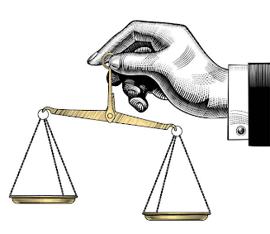
Time Complexity vs Space Complexity
Time Complexity:
  Measures how fast an algorithm runs.
Space Complexity:
  Measures how much memory an algorithm uses.
Trade-Off:
  Sometimes, you can save time by using more memory, or save memory by using more time.
Time
Space

Slide 57
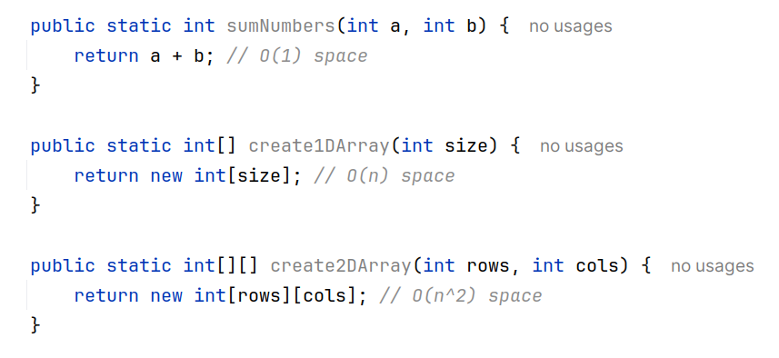
Examples
Doesn’t matter if we are using a loop to initialize the array or not

Slide 58
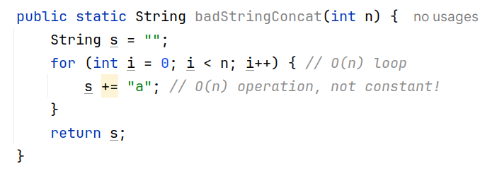
Pitfall
String concatenation may not be constant as we might think!

Slide 59
Pitfall
String concatenation may not be constant as we might think!

Slide 60
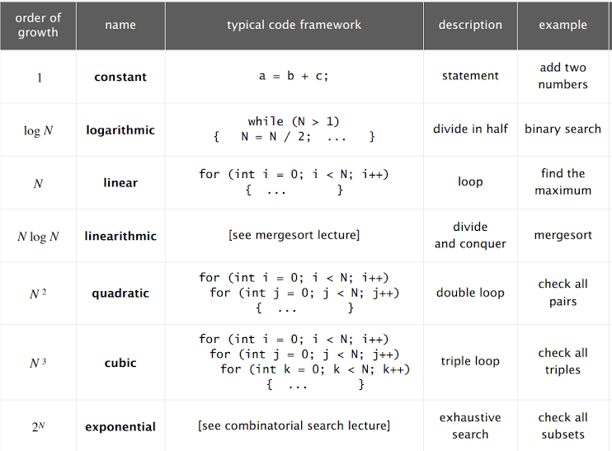
Some Common Order of Growth Functions

Slide 61
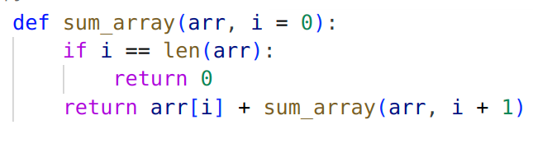
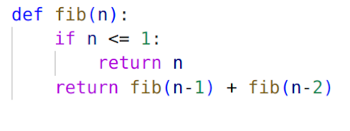
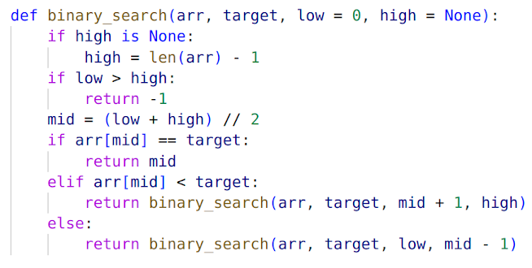
Things Can Get Complicated 😬
O(n)
O(2^n)
O(logn)

Slide 62

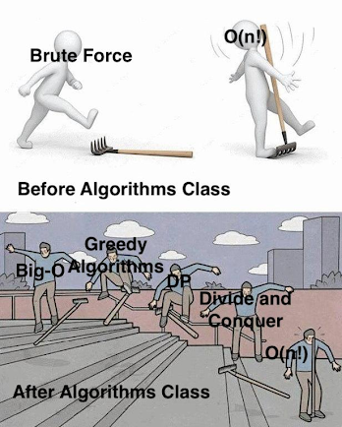

Conclusion: Efficiency Beats Raw Power
A supercomputer can perform trillions of calculations per second.
But if it runs an inefficient algorithm (e.g., )
it can still struggle with large inputs.
A normal computer running an efficient algorithm
(e.g., ) can outperform a
supercomputer running an inefficient one.

Slide 63
Homework
You have an n-bit secret integer. What would be the time complexity of an algorithm that tries to guess this integer?
Find the space complexity of storing all possible permutations of a given string.
Find the time complexity of generating all possible subsets of a given set.
  Hint: {1,2,3} ⇒ { {}, {1}, {2}, {3}, {1,2}, {2,3}, {3,1}, {1,2,3} }

Slide 64
Homework
You have a list of integers. Find pairs of integers (a,b) such that a+b = 0
  O(n^2) time ⇒ Brute force
  O(nlogn) time ⇒ Sorting + Binary search
  O(n) time ⇒ Hashmap (Will study later in this course)
  Try to figure out the space complexity for each approach!

Slide 65
Reading Materials
https://medium.com/@hlfdev/algorithms-discover-the-power-of-big-o-notation-17a367bd62a

Slide 66
